Slide 1

Level: Basic – Session 10
Particles in Unity
Omid Saadat

Slide 2
Particles
What are particles?
What can we do with them?
  Fire, rain, smoke
  Portals
  Trails
  VFX

Slide 3
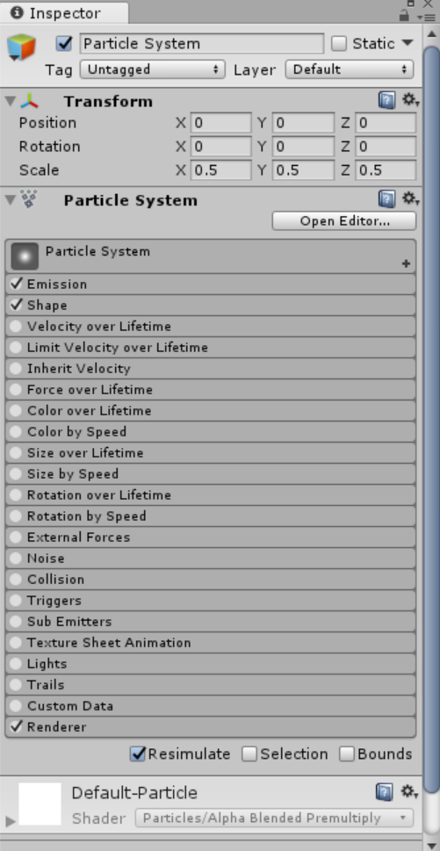
Shuriken
Unity builtin particle system.
How does it work?

Slide 4
I need more Ideas
Follow Mirza in Youtube
Check Unity Particle Pack Asset

